Slide 1
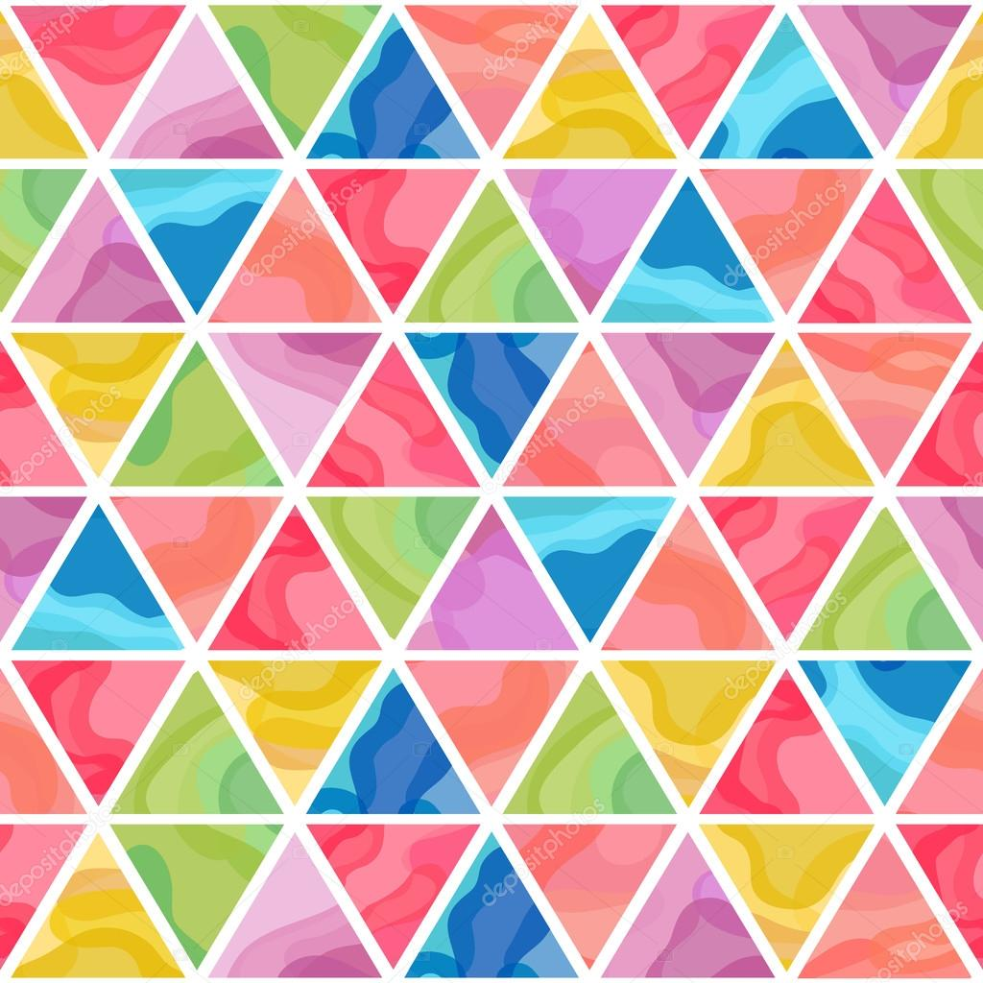
Patrones Hermosos

Slide 2

What are you nervous about this week?

Slide 3
Team Assignments (announced by TAs!)

Slide 4
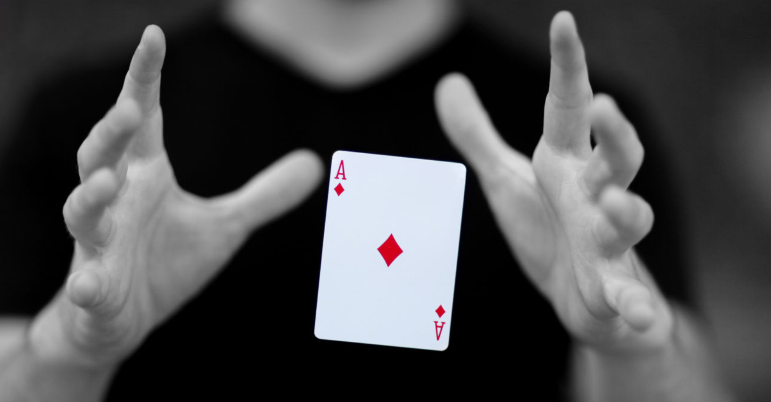
Magic Trick!

Slide 5
Your Turn!
In your teams, try to figure out the trick!
Have one representative do it for another team
See who’s the best!

Slide 6

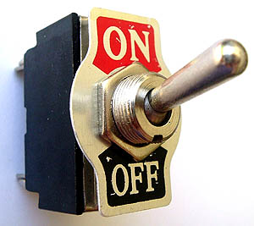

Slide 7
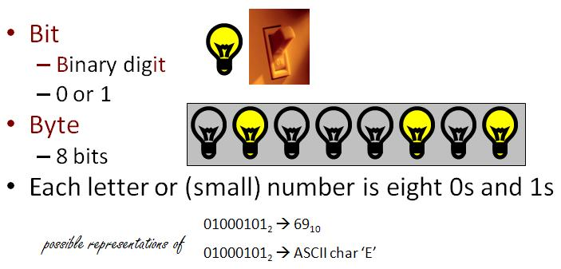

Slide 8
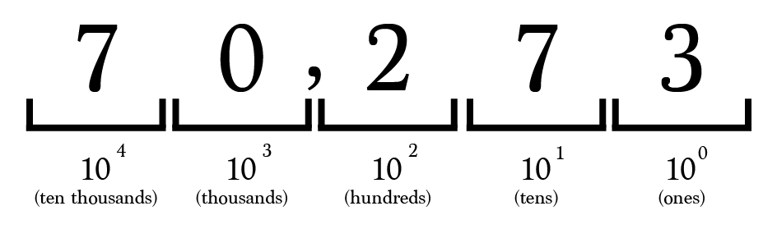
70,273

Slide 9
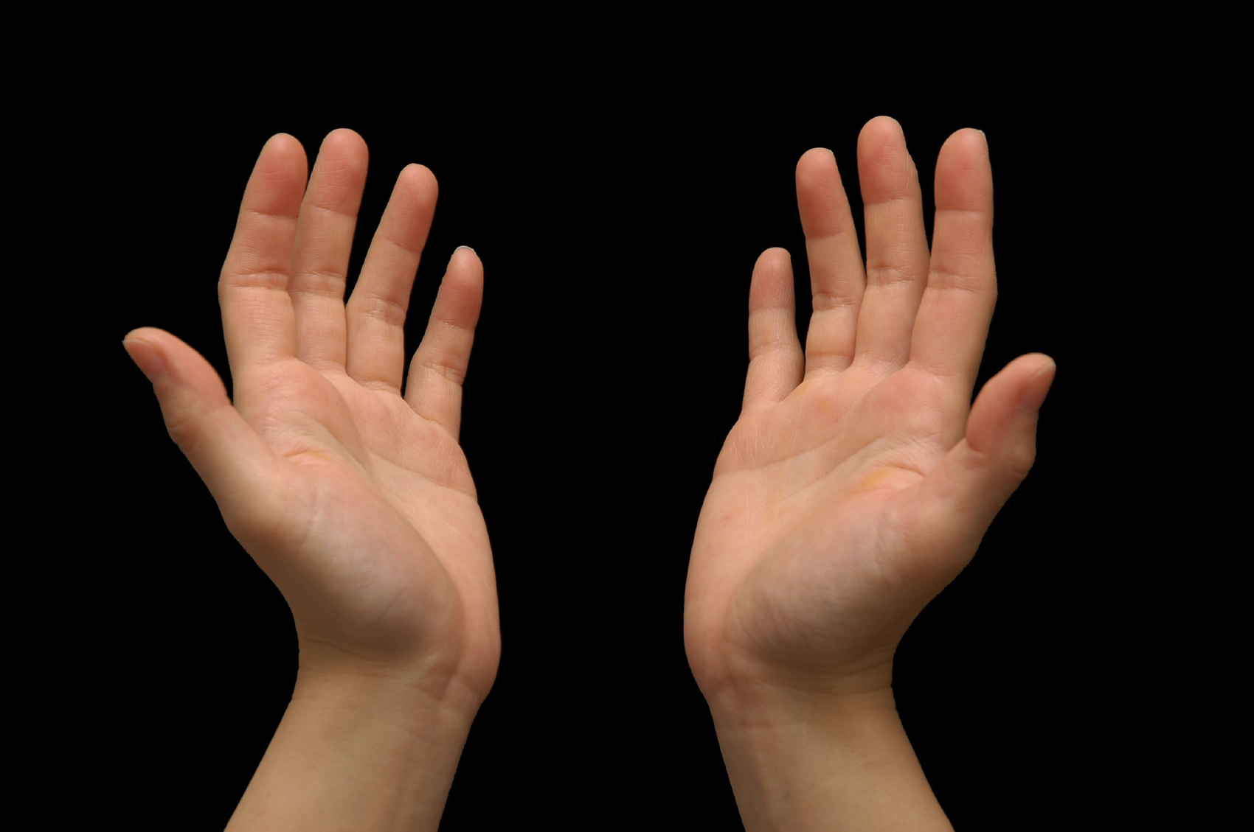
Why do we count in multiples of 10?

Slide 10
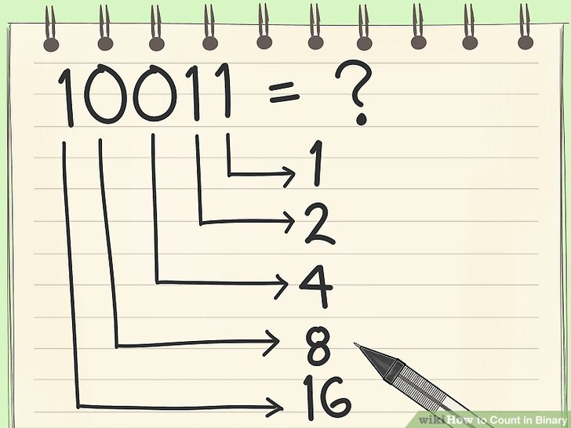
Why not count in multiples of 2?

Slide 11
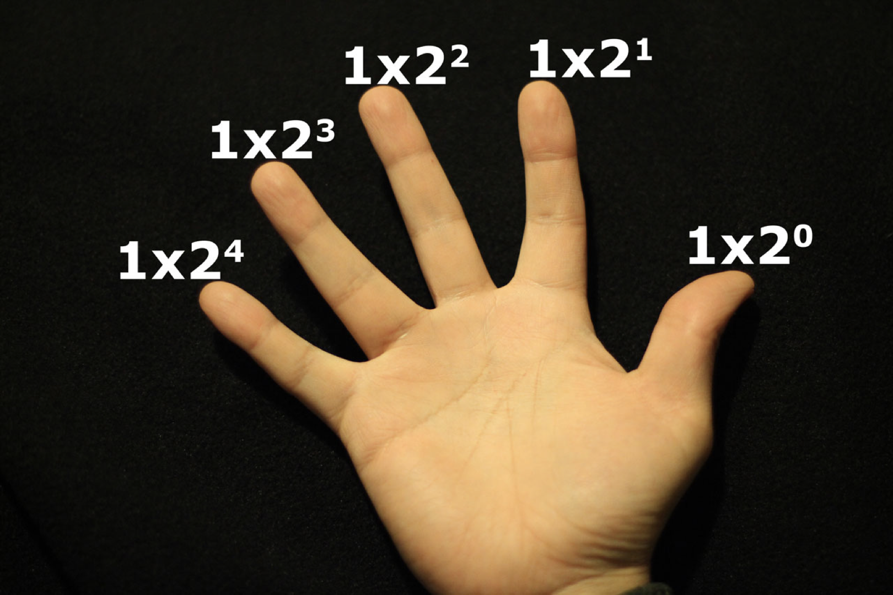

Slide 12
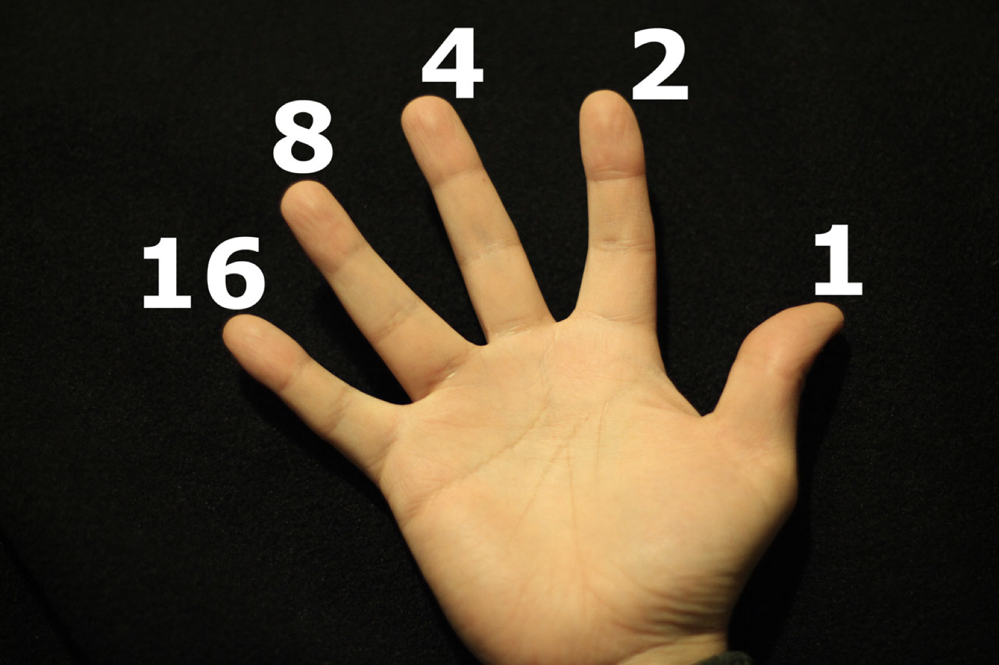

Slide 13
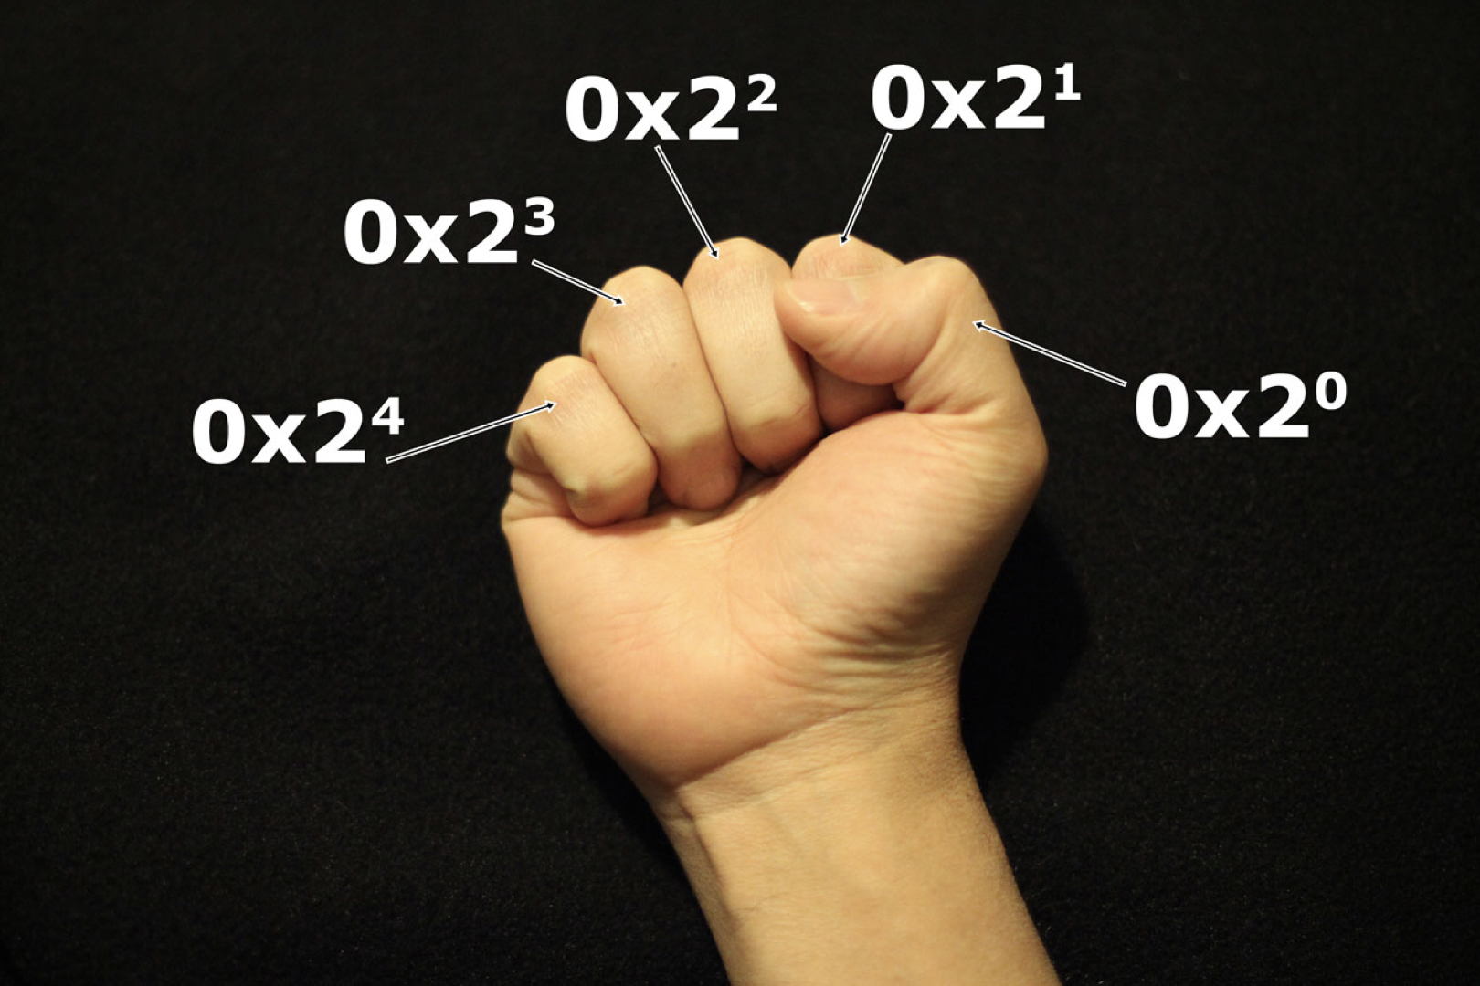

Slide 14
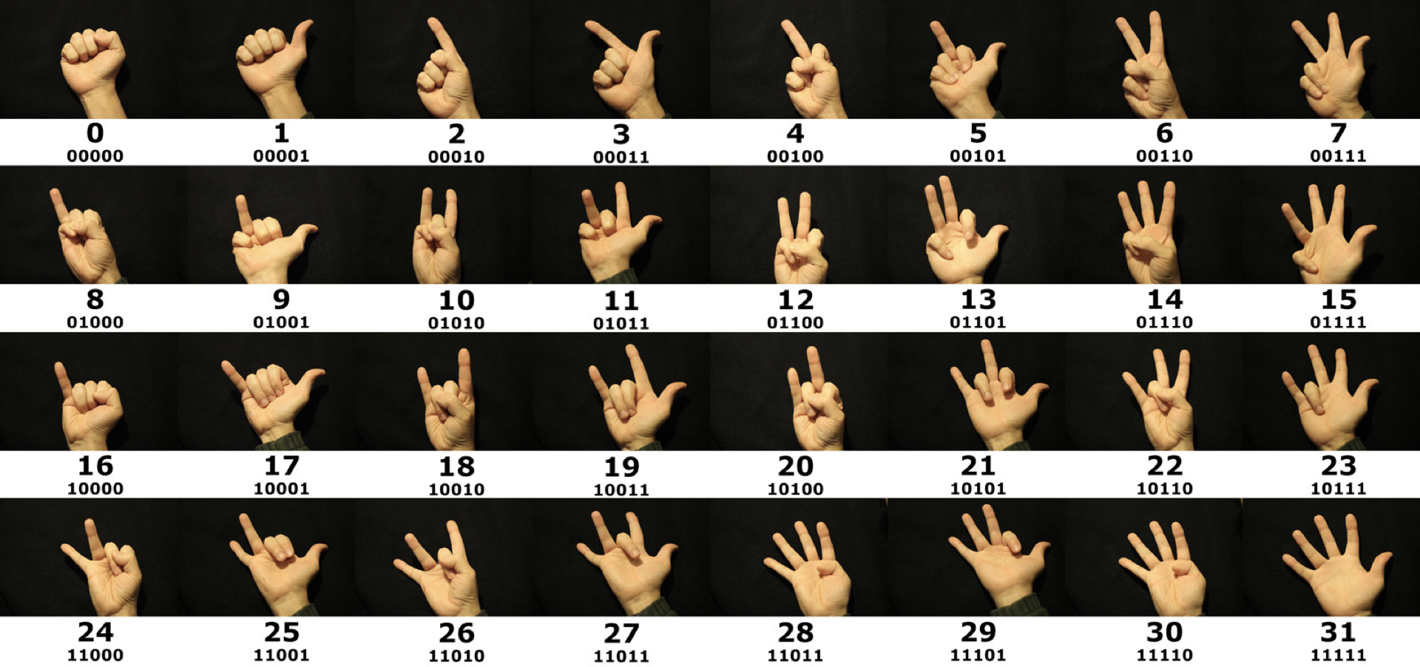

Slide 15
Competition!
0100 =
1000 =
0111 =
1011 =
4
8
7
11
0000 =
0011 =
1111 =
1100 =
0
3
15
12

Slide 16
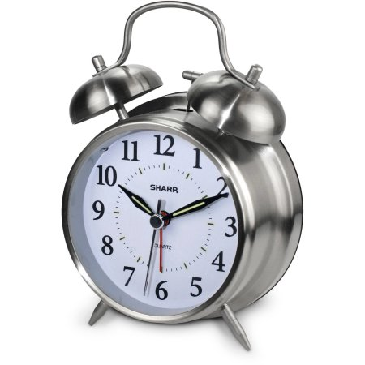
Design a Binary Clock

Slide 17
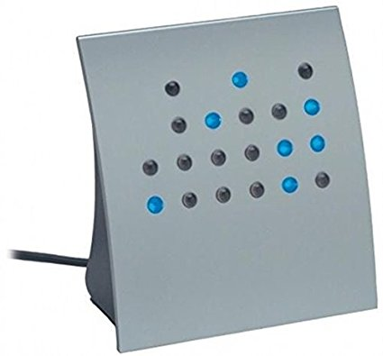
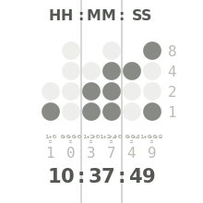

Slide 18
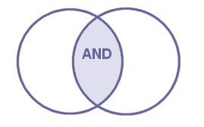
Boolean Algebra
&&
A | B | A and B
0 | 0 | 0
0 | 1 | 0
1 | 0 | 0
1 | 1 | 1
Notes:
Boolean algebra exercises to fill time, in case the other content is exhausted

Slide 19

Boolean Algebra
||
A | B | A or B
0 | 0 | 0
0 | 1 | 1
1 | 0 | 1
1 | 1 | 1

Slide 20
Calculate
(1 || 0) && (1 && 0)
(1 || 0) || (1 && 0)
(1 || 1) || (1 && 1)
(0 || 0) && (1 && 0)
(1 || 0) && (1 && 0) || (0 || 1)

Slide 21
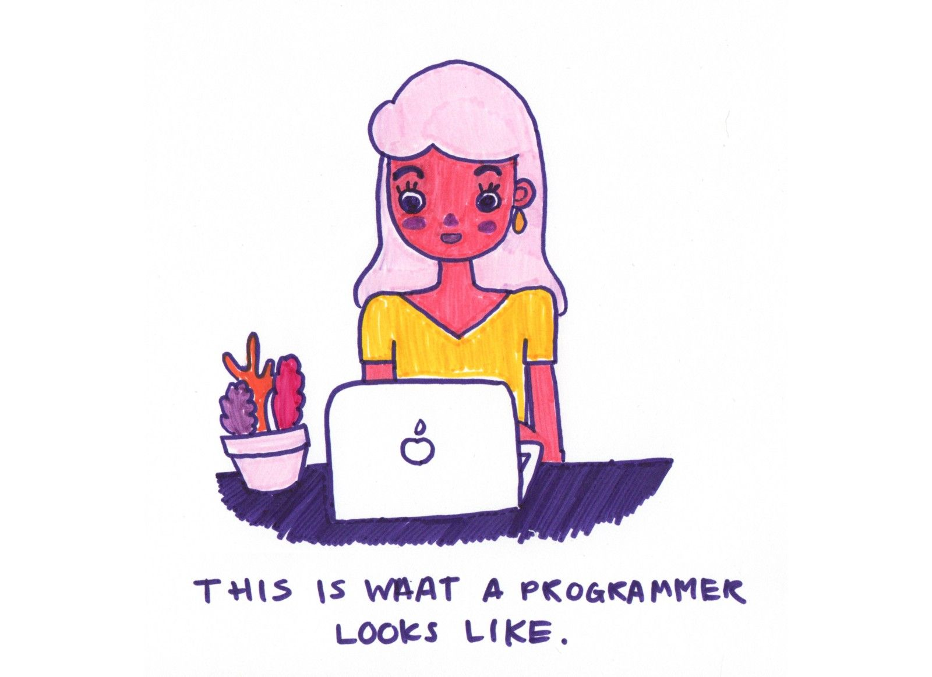
Coding Exercises

Slide 22
In All Coding Languages!
Variables
Arrays
Conditional statements
Loops
Functions

Slide 23
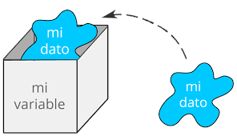
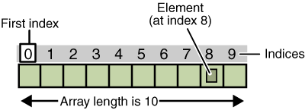
Variables
http://www.spanish411.net/SpanishMadLibs/
Arrays
A list of variables!

Slide 24
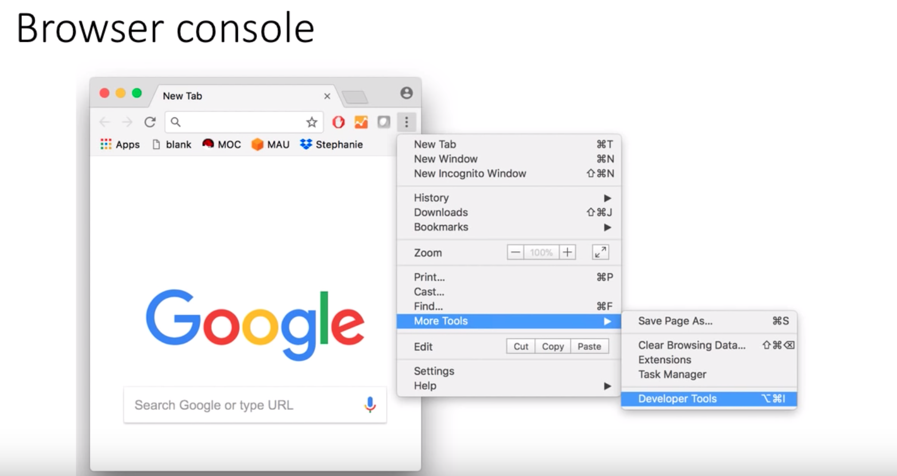

Slide 25
Go to: https://dreamgrande.io/workshop
Go to Tuesday

Slide 26
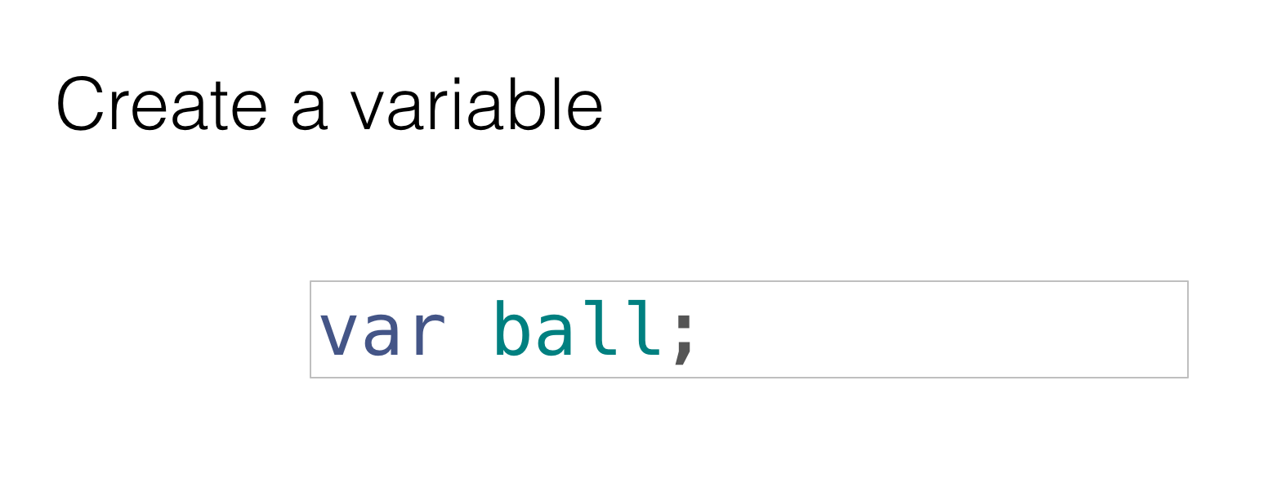

Slide 27
Calling Functions
// function calls
ball = create();
size(ball,200,200);
color(ball,255,0,0);
move(ball,50,50);
colorRandom(ball);
zIndex(ball,5);
repeatMove(ball, 10, 10, 5);

Slide 28
Loops
// loop exercise
var counter = 0;
while (counter < 10) {
create();
counter++;
}

Slide 29
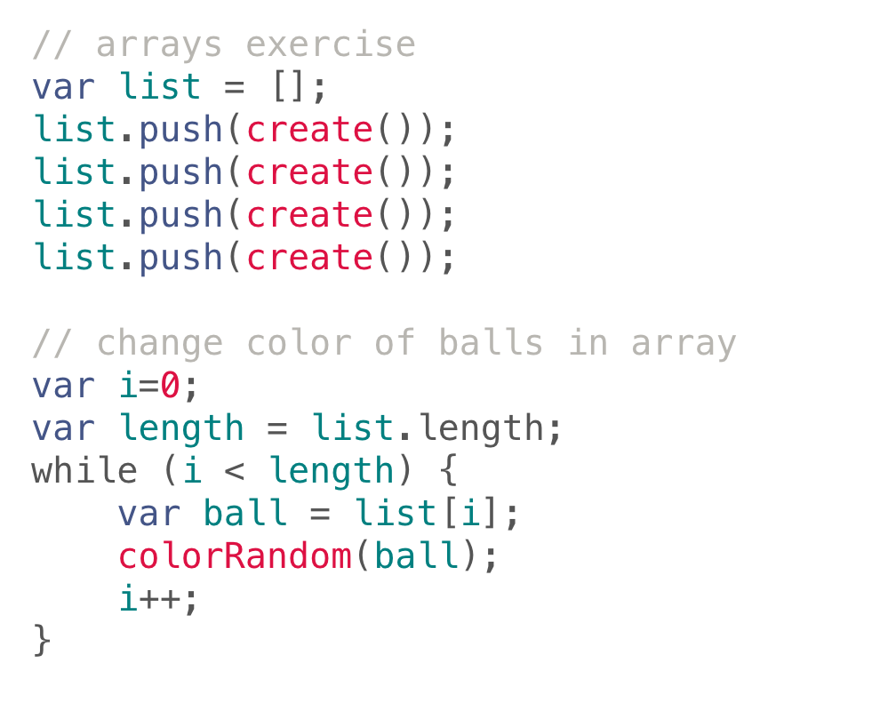
Arrays
Notes:
// arrays exercise
var list = [];
list.push(create());
list.push(create());
list.push(create());
list.push(create());
// change color of balls in array
var i=0;
var length = list.length;
while (i < length) {
var ball = list[i];
colorRandom(ball);
i++;
}

Slide 30
Painting 1 - Mona Lisa!
data is an array with the painting information
Get the length of data using data.length (eg: var length = data.length)
Loop through it, creating a ball at the location for each color
Some useful attributes: ball.x, ball.y, ball.color

Slide 31
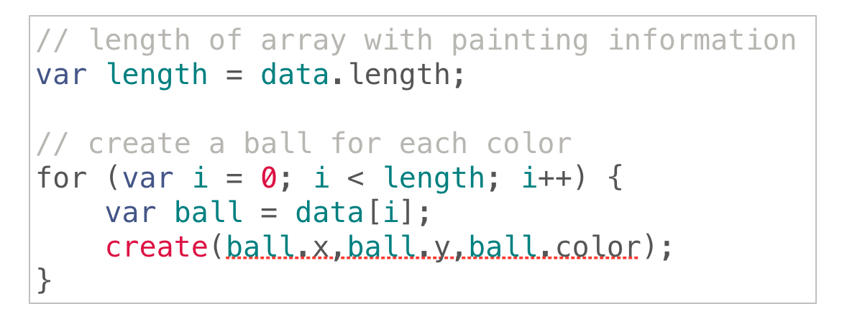
Mona Lisa Solution!
Notes:
// length of array with painting information
var length = data.length;
// create a ball for each color
for (var i = 0; i < length; i++) {
var ball = data[i];
create(ball.x,ball.y,ball.color);
}

Slide 32
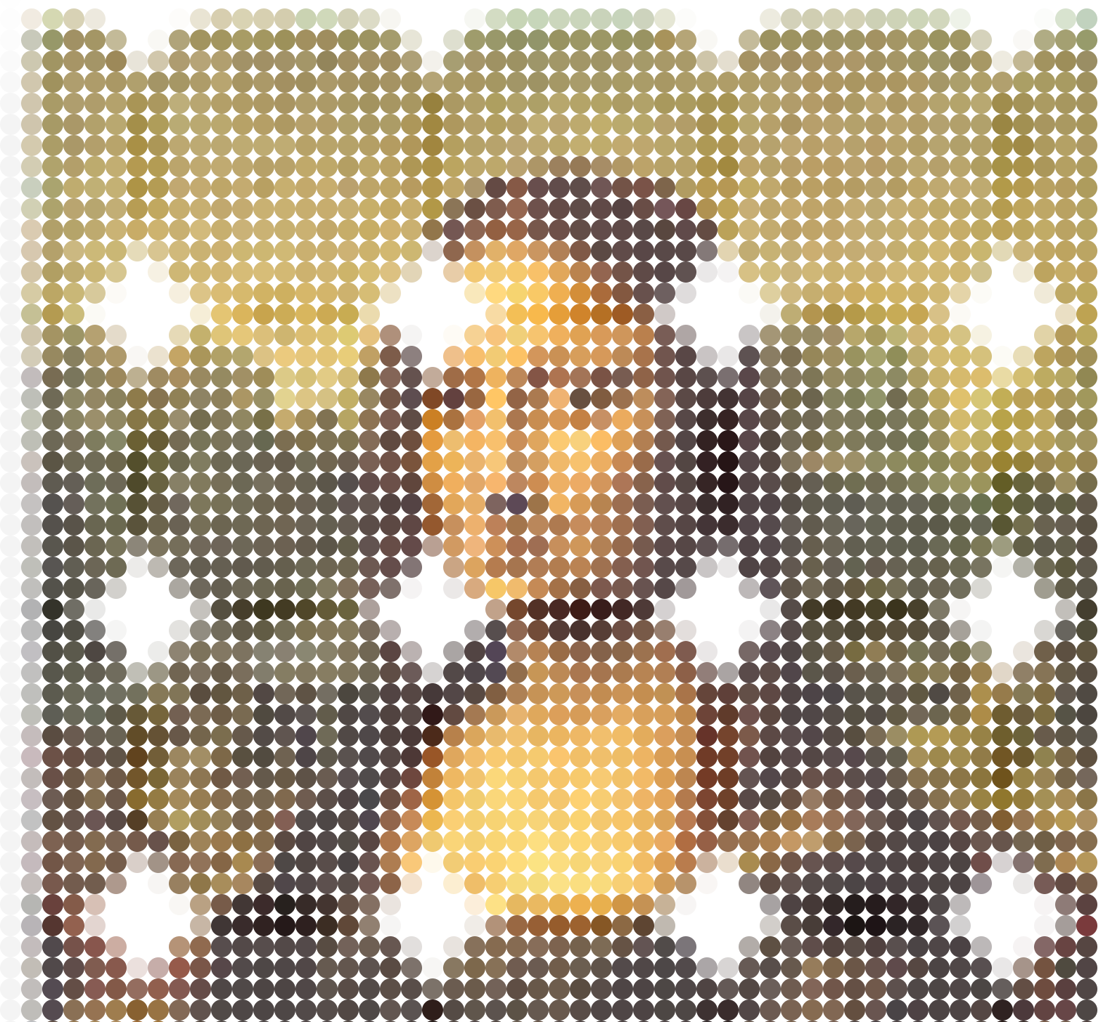

Slide 33
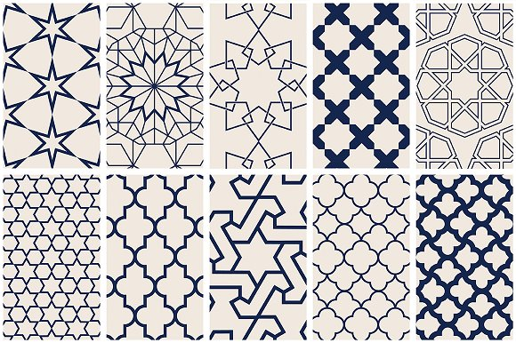
Milestone 1

Slide 34
End of Day Task - Reflection

